Slide 1
Creative Problem Solving Process
Incubation
Investigation
Idea Generation
Techniques
Inspiration
Identification
Improvement
Implementation

Slide 2
Rephrasing the Problem
Does the way we’ve phrased the problem limit or restrict our thinking?
Are we tackling the right problem?
Are we asking a “How can we….?” question?

Slide 3
Wide Angle Lens
“We need more followers on Instagram!”
“Why do we want more followers on Instagram?”
How can we attract a younger audience?
To attract a younger audience.
To raise awareness of our brand.
Possible Answers: Rephrased
How can we generate leads?
Possible Answers:
To generate leads.
How can we raise awareness of our brand?

Slide 4
Getting to the Root
Too Many Errors
Poorly skilled staff
Attention to detail lacking
High staff turnover
Lack of responsibility
Lack of training
Lack of job satisfaction
Supervisors too busy
Work is checked

Slide 5
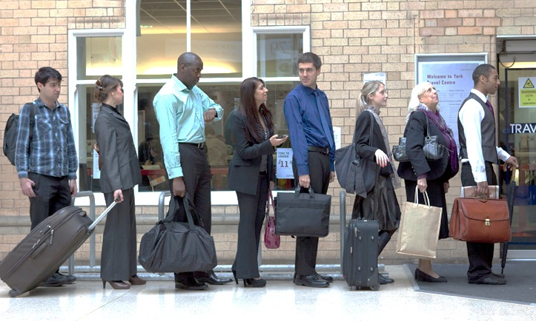
Problem
Reframed Problem
Our company runs a gym.
How can we increase the number of members in the face of growing competition from the tennis club down the road?
Imagine we run a bus company.
How could we attract people out of their cars and on to our buses?

Slide 6
Problem
Reframed Problem
We run a company in an area where many other companies are competing for the same staff.
There aren’t enough skilled staff to go around.
Imagine our river is being over fished.
What could we do?

Slide 7
Problem
Reframed Problem
We’ve expanded and now our car park is too small for the number of people who want to drive to work.
Imagine we run
a football club
that has been
promoted to the premier division.
What can we do about the additional spectators who will now want to come and watch the matches?

Slide 8
Problem
Reframed Problem
A major competitor has just opened up in the area.
How will we survive?
We’re going to have to walk into a cage of lions.
What will we do to make sure we come back out!?

Slide 9
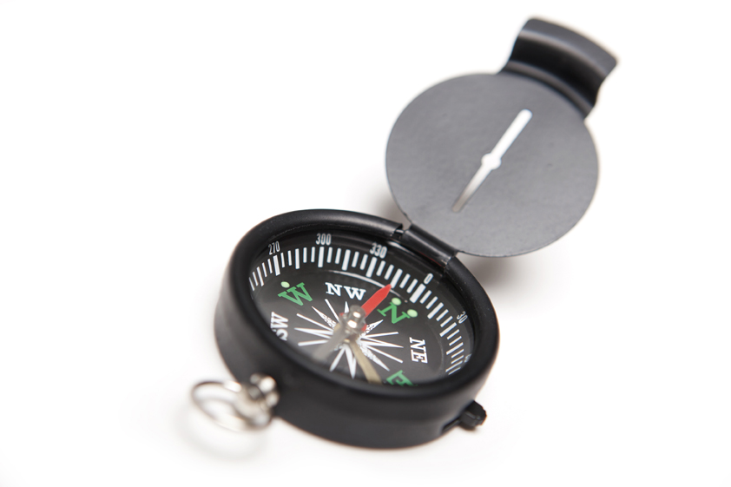
Problem
Reframed Problem
Due to a small fire, our offices have had to be closed and we need to find a way to keep going during the rebuilding.
We are fisherman and our boat ran aground.
What will we do whilst it’s in dry dock?

Slide 10
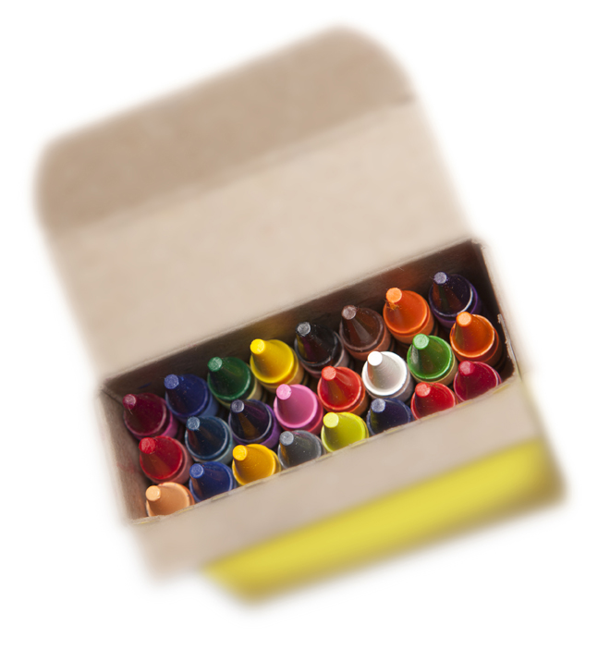
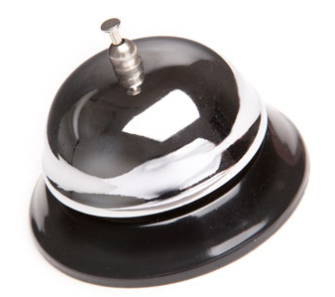
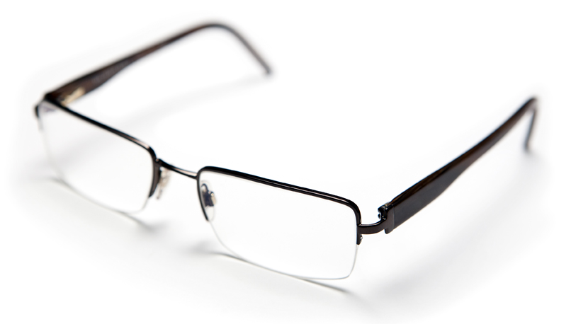
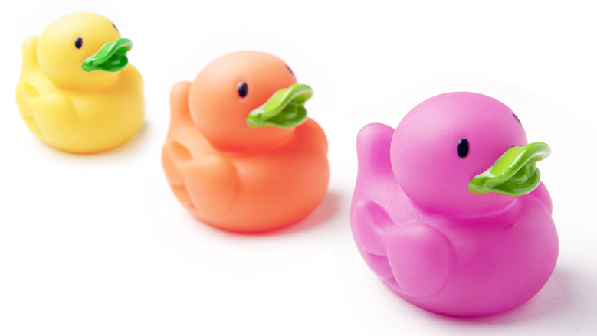
Forced Connections
Pick a random object.
Force a link between the object and the problem/situation you have.
What ideas does this give you?
Can you develop these?

