Slide 1
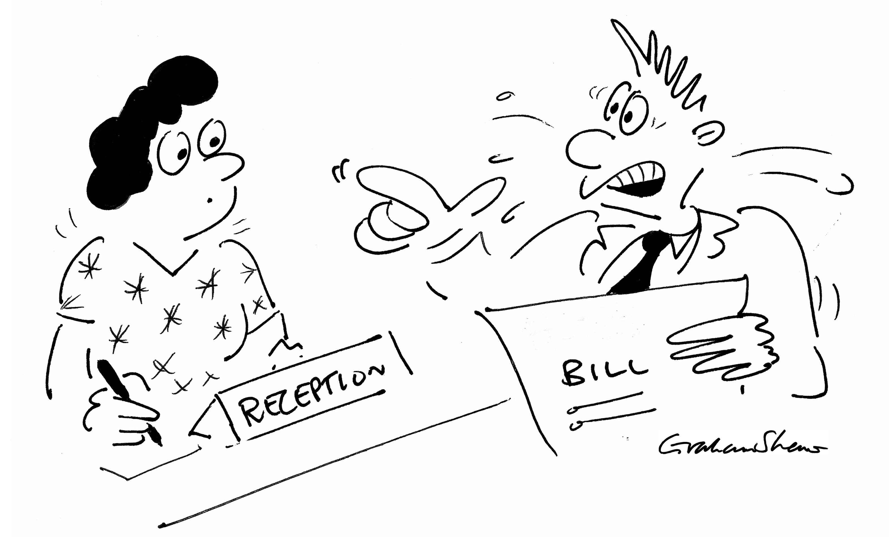
L is for LISTEN…
This is where you give the customer a chance to reveal what they are unhappy about.

Slide 2
A is for ACKNOWLEDGE…
This may be as simple as saying, “Thank you for sharing” or “I can see that this is upsetting for you” etc.
(Remember you do not have to agree with someone to show that you understand their situation.)

Slide 3
C is for CLARIFY…
This is where you check to ensure your understanding is correct, “If I have understood you correctly…”
It’s your chance to ensure you understand the exact problem that needs solving.

Slide 4
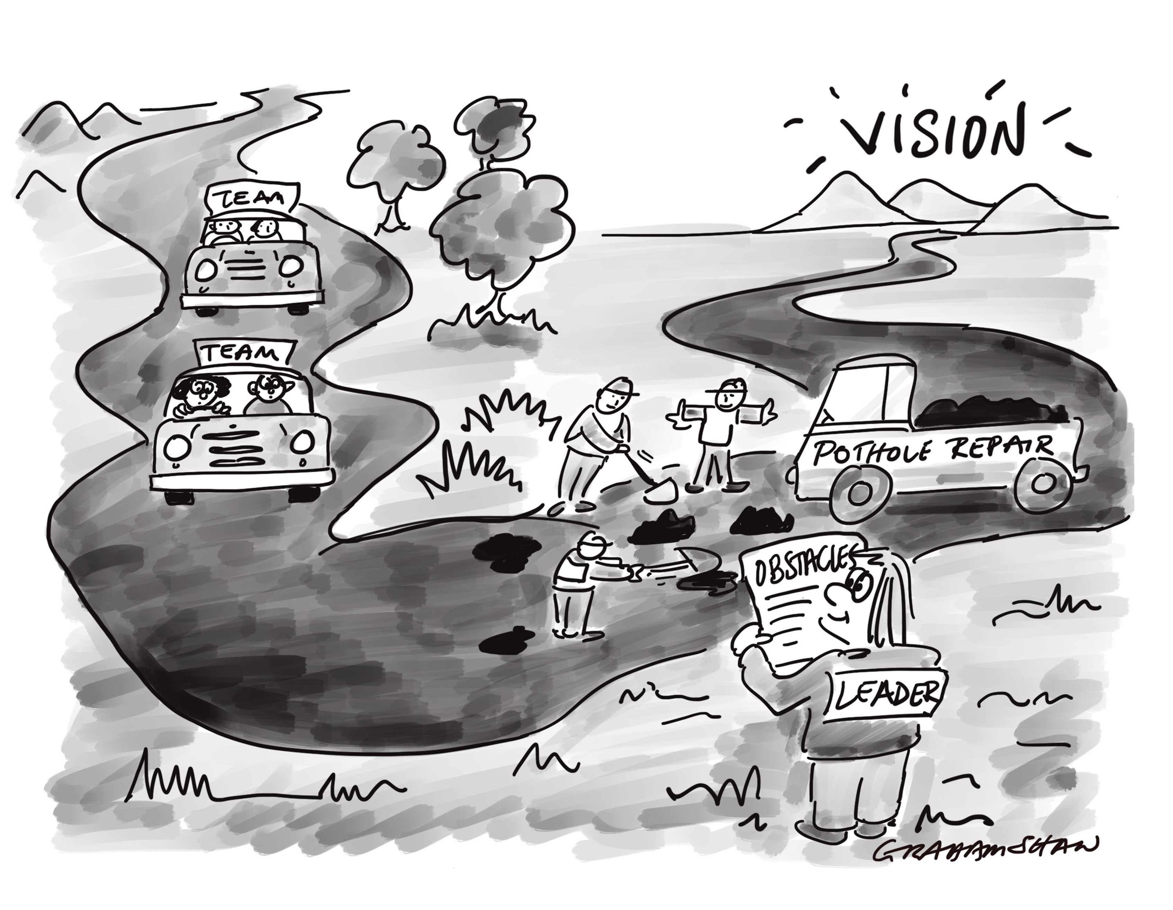
E is for EXPLAIN…
This is where you tell the customer what is going to happen next in order to resolve the issue.

Slide 5
L
is for LISTEN
A
is for ACKNOWLEDGE
C
is for CLARIFY
E
is for EXPLAIN

