Slide 2
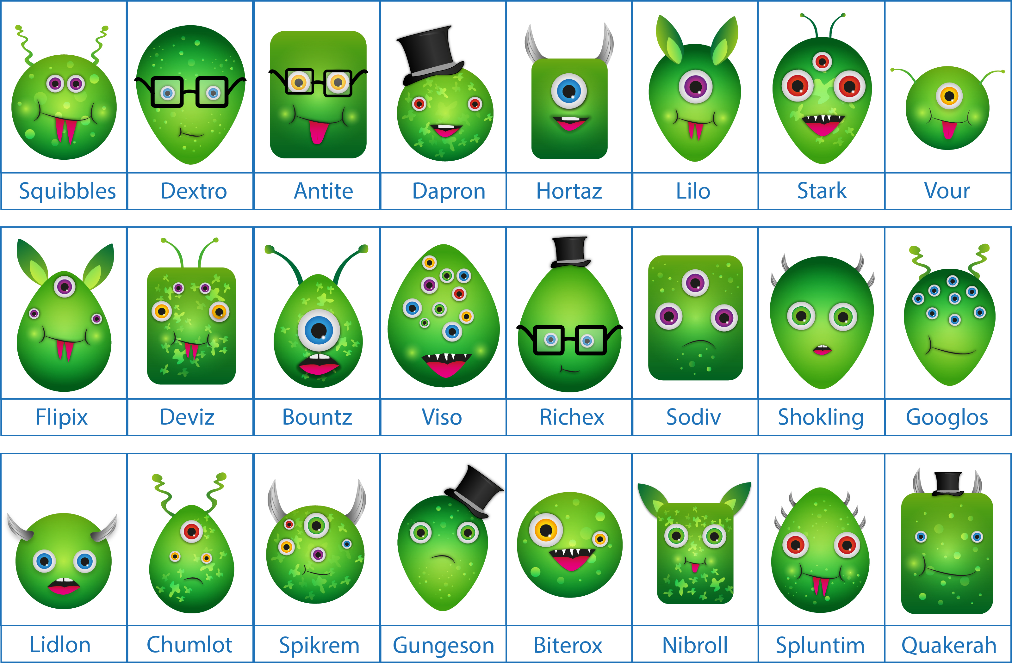
The Aliens

Slide 3





The Challenge
The task is designed to test powers of observation and recollection, and your ability to communicate relevant information quickly, clearly and accurately.
The candidates will have up to one minute to help the assessors identify Viso from a line-up of 24 aliens. The description they give you should be sufficiently clear for the assessors to accurately identify Viso.

Slide 4
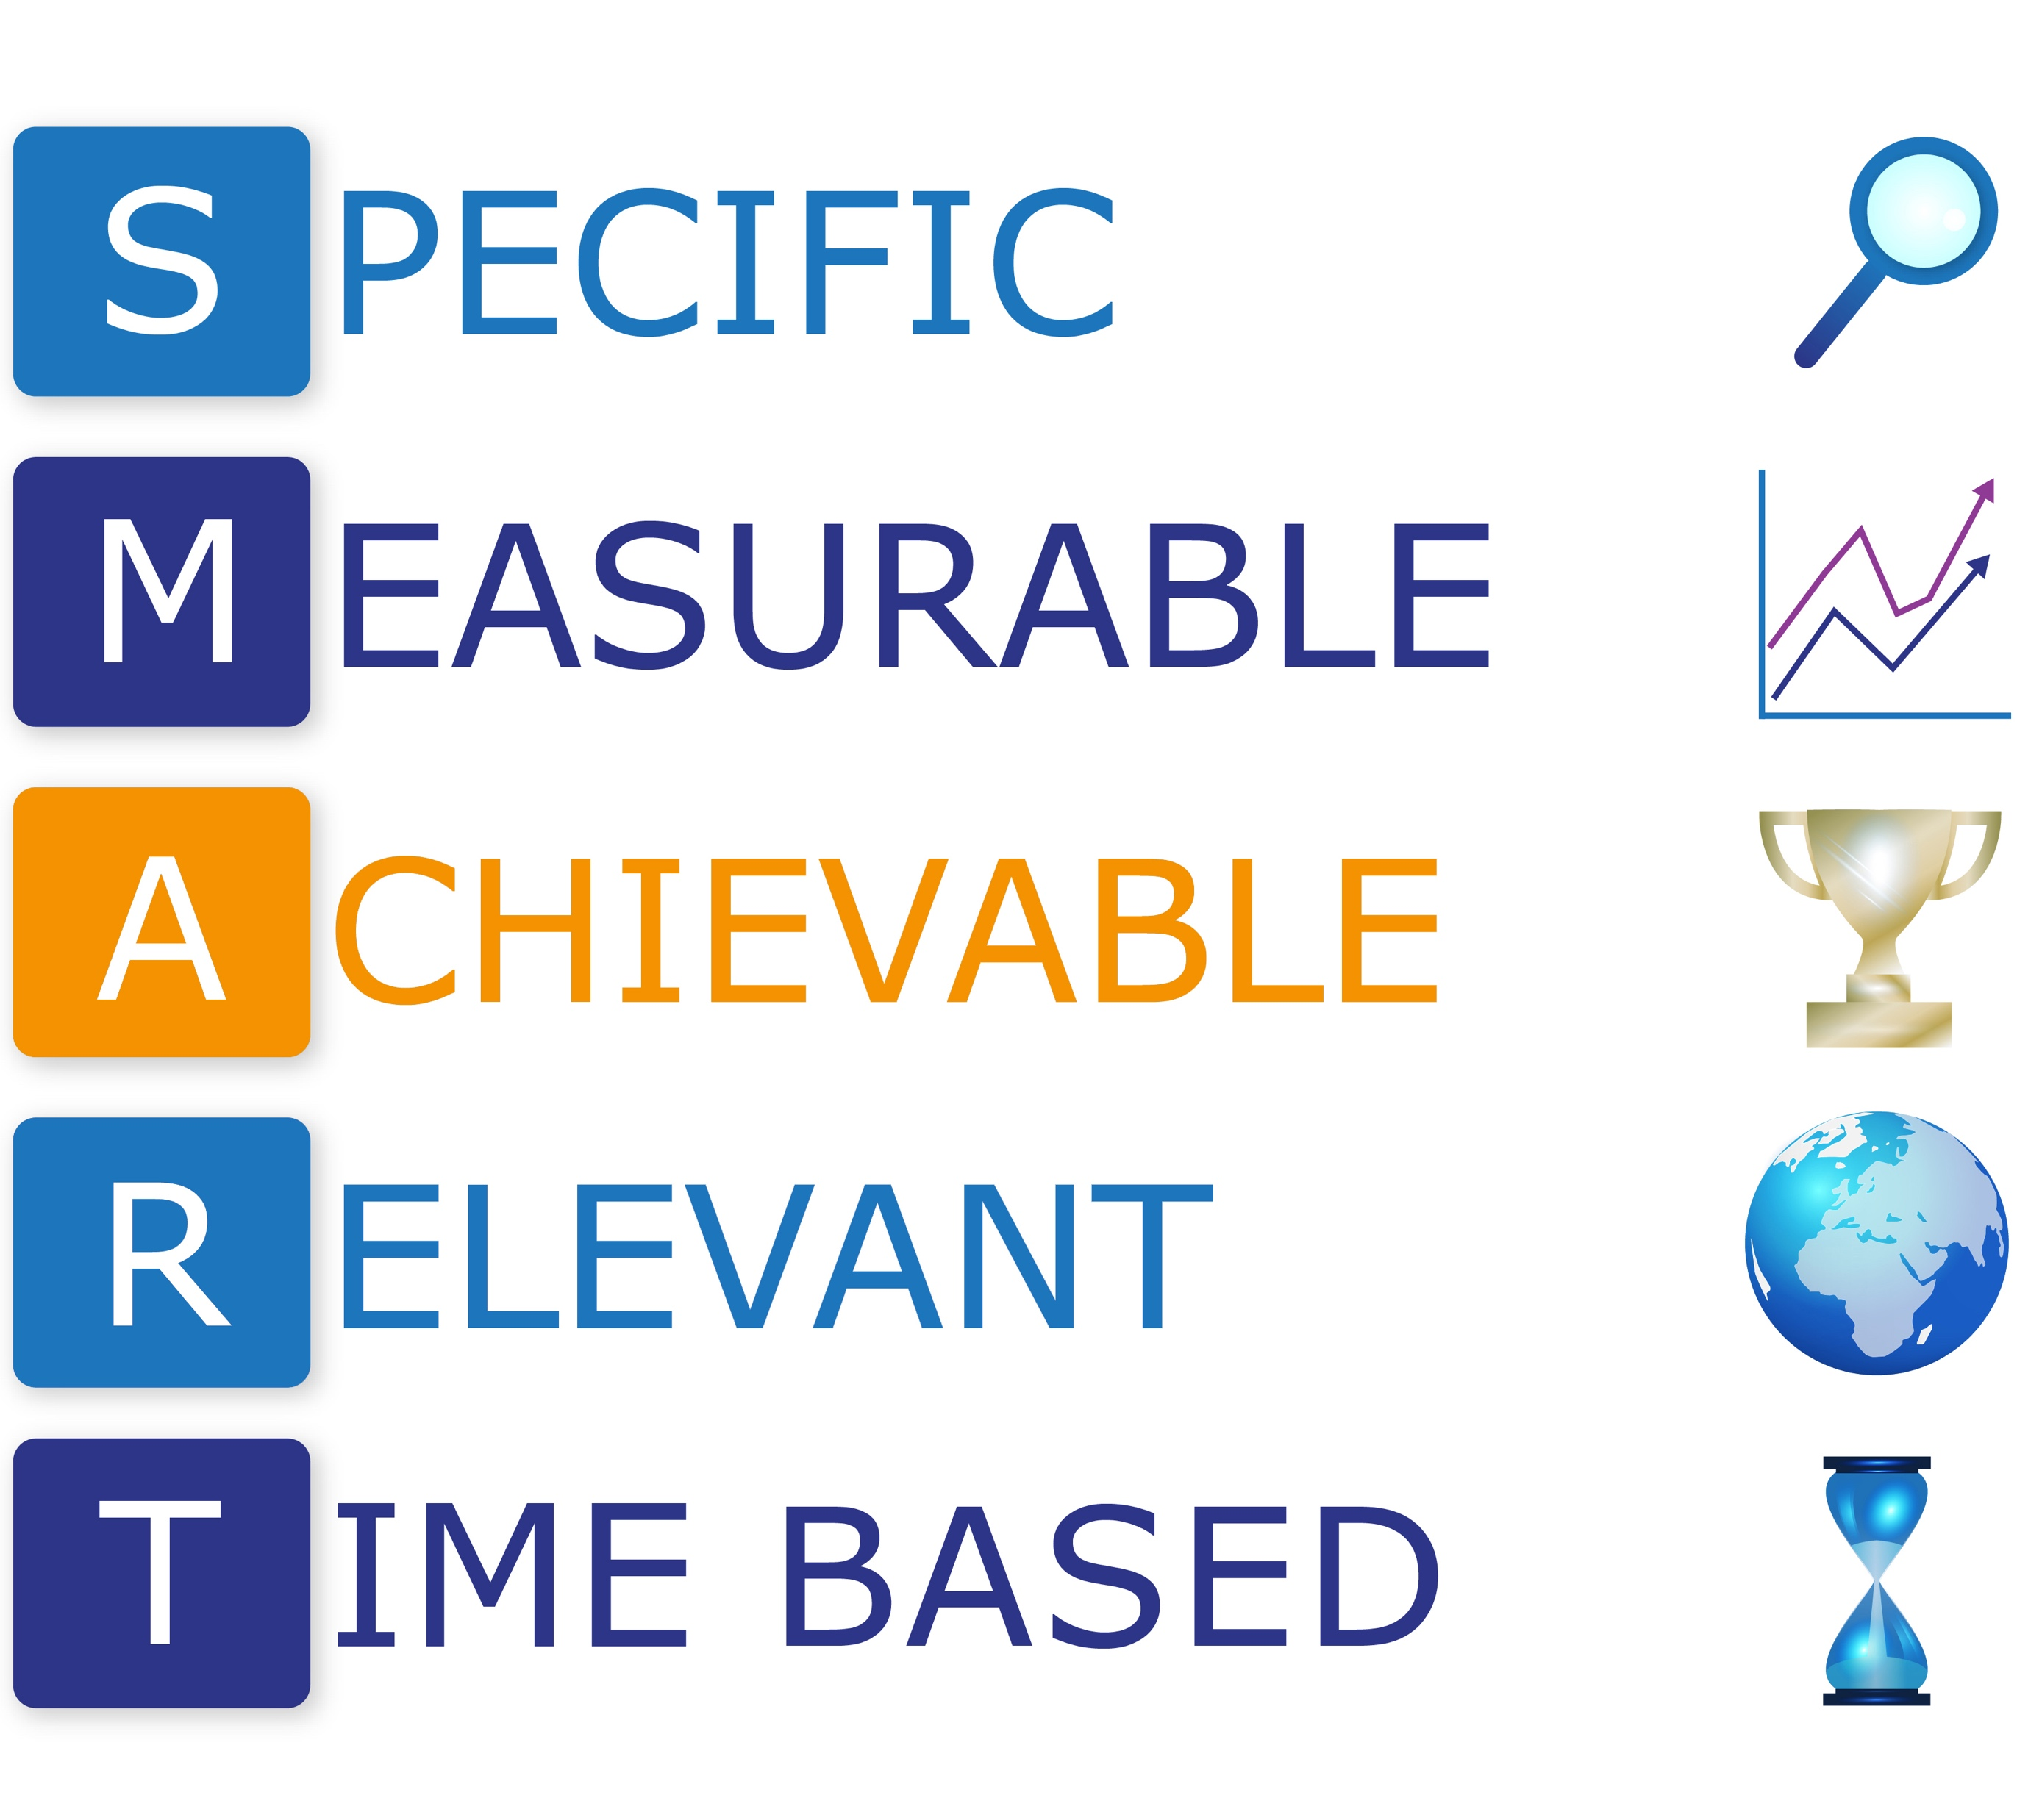

Slide 5

Workplace Challenge
“I want to reduce the number of customer complaints about Florence’s team.”
“I want to reduce the number of formal written complaints, or expressions of dissatisfaction received by email, phone or social media related to Florence’s team to fewer than five a month within three months.”

Slide 6
Workplace Challenge
To design and roll-out a customer service workshop focused on improving customer satisfaction and engagement to all members of Florence’s team within 4 weeks.
To introduce a form of accreditation for staff who achieve measurable levels of excellence in customer service and satisfaction within 6 weeks.
Florence to record and monitor at least 4 telephone conversations between members of her team and customers each week and provide direct feedback and coaching to the member of staff involved, with
a clear, agreed action for improving or maintaining standards following each one.

Slide 7

Feedback is a Gift
Information about performance or
behaviour that leads
to actions to affirm
or develop that
performance or behaviour.

Slide 8
The AID Feedback Technique
Action: State what the individual did.
Impact: Explain the impact of the observed behavior on you (positive or negative).
Do: Guide them as to what they should do in future to get a good outcome.
Notes:
Giving great feedback can seem daunting at first, but we have a great model that will AID you with structuring the feedback
A – Action – specify what the individual did
I – Impact – the result of the behaviour (positive or negative)
D – Do – what they should do in future to get a positive result

