Slide 1
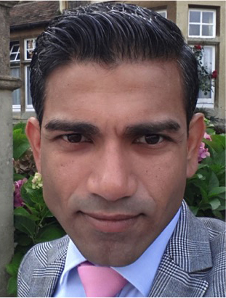
Ask the Expert
Each team will have 5 minutes to interview Arnav and get his advice.
Notes:
Arnav Premnath

Slide 3
What is a Stakeholder?
A person or organisation who:
Is actively involved in the delivery of a project,
And/Or
Will be impacted (either positively or negatively) by the project’s implementation.

Slide 4
Analysing Your Stakeholders
Influence/Power of the Stakeholder
VIPs:
Manage them closely
Keep them satisfied
Keep them informed and engaged
Inform them
Interest levels of the Stakeholder
Notes:
You can move people to the right but unlikely that you will be able to move them upwards…

Slide 5
The Street Party Stakeholders
 |  | TM |  |  |  | BT |  |  | RFH
 |  |  |  |  |  |  | COB |  | H
 |  |  |  |  |  |  |  |  | LS
 |  |  |  |  |  |  |  |  | BC &SC
 |  |  |  |  | P& CF
COG |  | MSH |  |  |  |  |  | TC
Influence/Power of the Stakeholder
Interest Levels of the Stakeholder

