Slide 1

Who Represents your
Biggest Managerial Challenge?
Create your character.
Name him or her.
Identify the attributes or behaviours that you want to manage better.

Slide 3
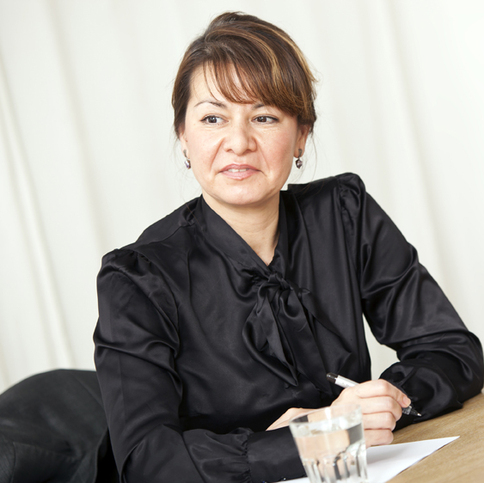
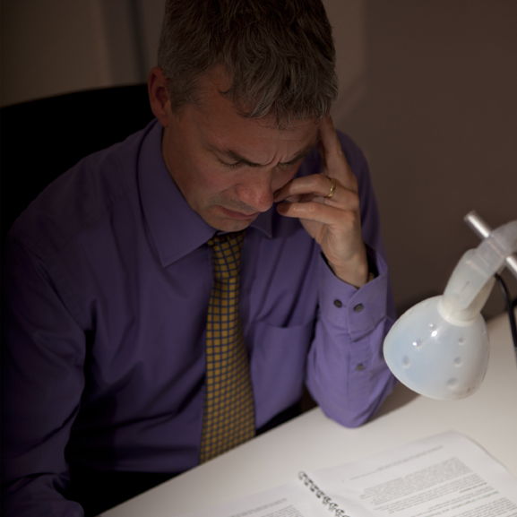

Triangle of Responsibility
The Protector
The Planner
The Provider

Slide 4

Specific:
“I probably need to
get better at my timekeeping.”
“I will set my alarm
so I get up
10 minutes earlier.”

Slide 5
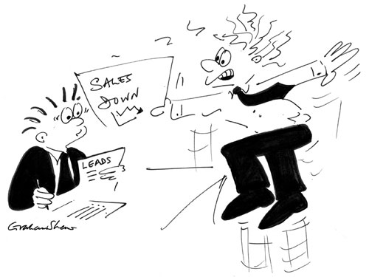
Measurable:
“Just stop being so late all the time.”
“You must be at your desk, logged on to your computer by 8:30am every morning.”

Slide 6
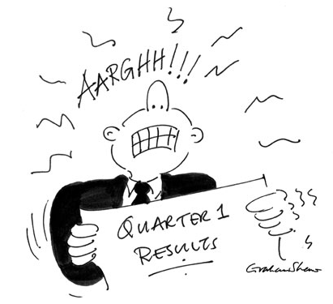
Achievable:
“Just stop being so
late all the time.”
“You must be at your desk, logged on to your computer by 8:30am every morning.”
“You must be at your desk, logged on to your computer ready to commence work at 9:15am every morning.”

Slide 7
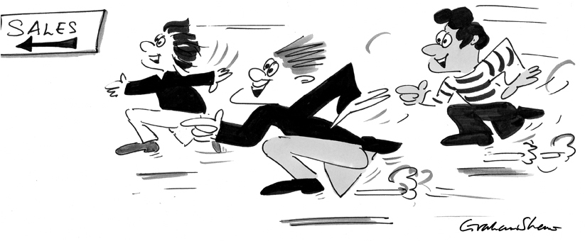
Relevant:
“You must be at your desk, logged on
to your computer ready to commence
work at 9:15am every morning.”
“You must report to the Checkout
Supervisor ready to commence work
by 9:15am every morning.”

Slide 8

Time Based:
“Your target for Quarter 2 is to have
a 100% record of reporting to the Checkout Supervisor ready to commence work by 9:15am
every morning.”
“You must report to the Checkout Supervisor ready to commence work by 9:15am every morning.”

Slide 9
Manager Feedback Wheel
Is able to adapt
approach as needed
10
Analyses situations accurately and considers all options
Takes the tough
decisions well
9
8
7
6
5
4
Creates and maintains
a great working atmosphere
Is supportive of others
3
2
1
0
Sets clear expectations
Gives feedback
constructively
Influences and motivates others
Questions effectively
Listens carefully

Slide 10
Manager Feedback Wheel
Is able to adapt
approach as needed
10
Analyses situations accurately and considers all options
Takes the tough
decisions well
9
8
7
6
5
4
Creates and maintains
a great working atmosphere
Is supportive of others
3
2
1
0
Sets clear expectations
Gives feedback
constructively
Influences and motivates others
Questions effectively
Listens carefully

