Slide 1




Credibility
5
Strong on expertise.
Weak on relationship.
Strong on expertise.
Strong on relationship.
4
Perceived Expertise
3
Weak on expertise.
Weak on relationship.
Weak on
expertise.
Strong on relationship.
2
1
1
2
3
4
5
Strength of Relationship

Slide 2



The Games People Play
Resistance and Revolution Game
Played against higher level players – often seen as kicking against ‘Authority’ or ‘They’. Can be led by Trades Unions but more usually comes from small, informal cadres within teams.
‘Smash the Revolution’ Game
The higher level players fight back.
Favouritism
Game
Played by lower level players who want to build their personal power by bonding with powerful superiors.

Slide 3


The Games People Play
King of the Castle
Played particularly by middle and senior managers who build their power base by increasing their resources, e.g. staff, budgets, buildings, functions, departments.
Gang Game
When there’s more than one king (or queen) of the castle game going on then this is the game which may be played next. The rivalry is often between departments (the classic Sales versus Production rivalry) but it may also be over values, goals and visions.

Slide 4


The Games People Play
Knowledge
and Skill Game
Played by ‘experts’ who use the ‘mystery’ of their technical skills and knowledge to hold power over others. Typically, they over-emphasise the difficulty of what they do to keep others in their place.
Promotion and Position Game
Often played by new managers in middle and senior positions who bring in their own candidates to increase their power and safeguard their territory.

Slide 5
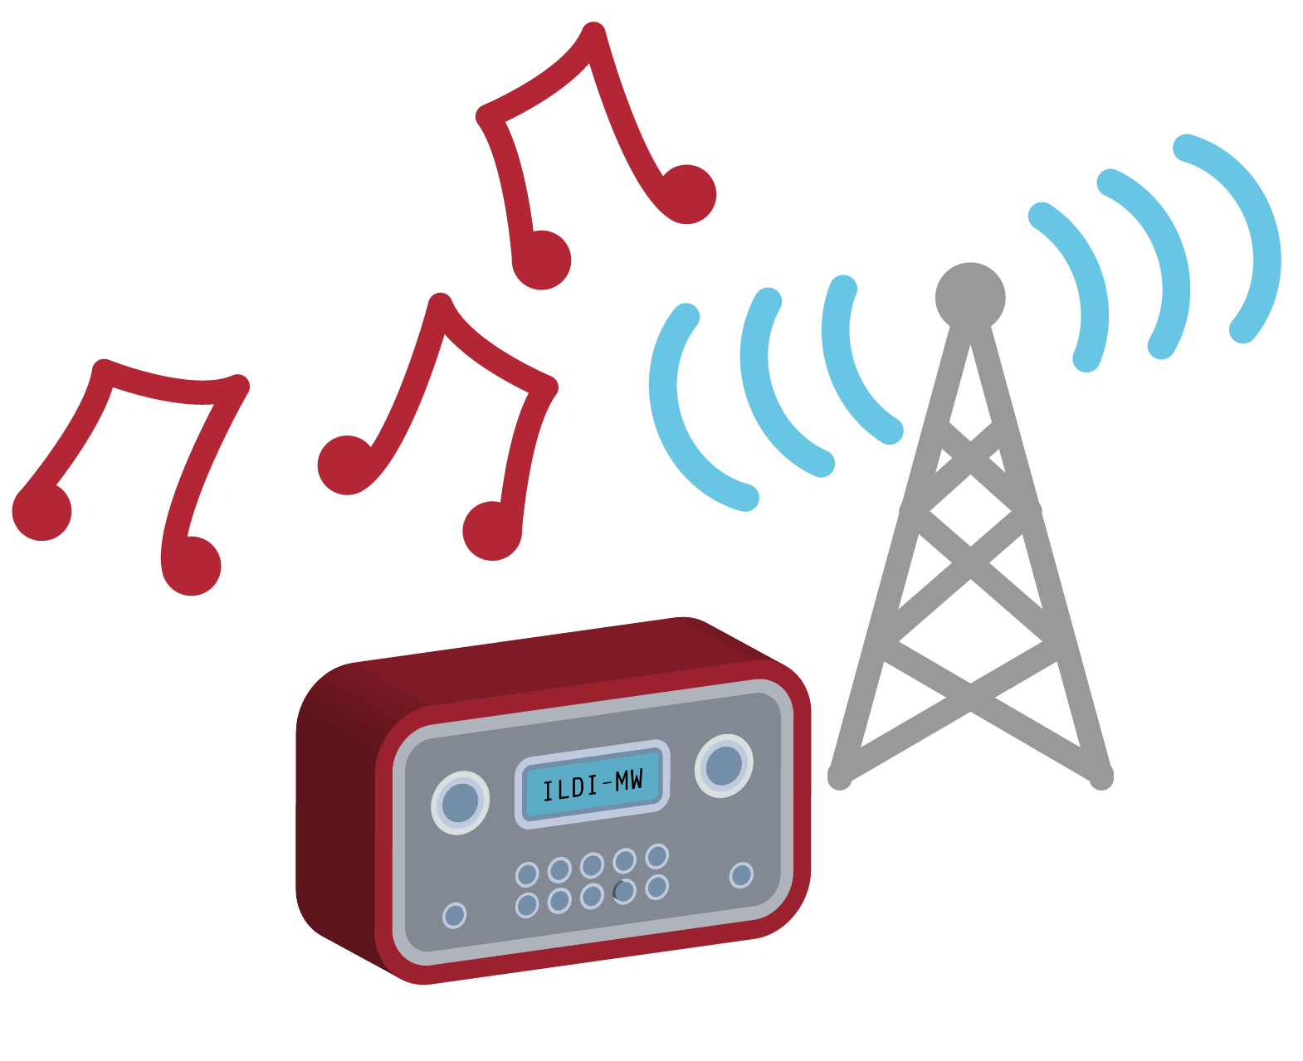
Internal Radio Stations
ILDI-MW
TIF-FM
MMFG-AM
WII-FM
Notes:
You start at:
ILDI-MW – I like doing it my way.
The radio station most of us are happy listening to
You need to get to:
TIF –FM – This is fantastic for me
The radio station the person influencing needs to get you listening to
You can only get there if they are happy with:
WII-FM – What is in it for me?
No one ever changes their behavior without getting a satisfactory answer to this most important of questions.
Very close on the dial and likely to create distortion is:
MMFG-AM – Make me feel good about myself
No one likes the feeling when they doubt themselves and it can drown out all other noise.

Slide 6

Ask the Expert
Each team will have 5 minutes to interview Arnav and get his advice.
Notes:
Arnav Premnath

