Slide 1
Dealing with Unexpected Interruptions
Specify how much time you’ve got.
Arrange a better time.
Use a flag to indicate periods when you should be left alone.

Slide 2
Managing Outbound Telephone Calls
Consider other’s prime time.
Group them together.
List everything you want to discuss; deal with them in one call.
Arrange a specific time to call.
Listen, summarise and make legible notes.

Slide 3
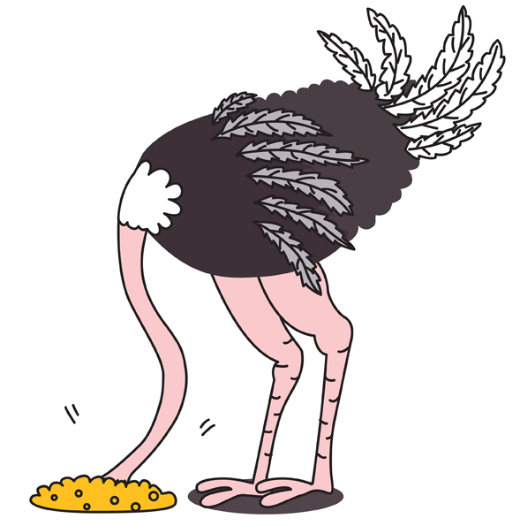
Procrastination
Get started!
Set aside designated time.
Break the task up into easily managed chunks.
Analyse your fears.

Slide 4
The Swiss Cheese Method
Turn the task into a series of subtasks (the holes).
Get started on it; even if you have only a few minutes.
Identify the first subtask in the sequence.
Tell yourself that since you are only spending a few minutes on the task, it doesn’t matter if you don’t enjoy it.

Slide 5
Clutter
Use staples or bulldog clips.
Clear your workspace of anything not related to the task you are working on.
When you finish working on a task, clear everything related to it away.
Use the bin!
Handle each piece of paper as few times as possible.
Use a highlighter to highlight key points.

Slide 6
Systems Problems
Don’t wait – do something else.
Reschedule work.
Use the time to do some non-urgent, non-important tasks.
Share information.

Slide 7
Staffing Issues
Identify anyone able to work extra hours or take on more work.
Reprioritise the work.
Tackle performance issues early on.
Invest some time in training. It saves time in the long run.

